Slide 1
Introduction to Python
Dr. Idoia Ochoa
Data Science

Slide 2

What is Python?
High-level, general-purpose programming language.
Known for its simplicity and readability.
Object-oriented.
Interpreted approach (i.e., code executed line by line, rather than compiled).
Dynamically typed, i.e., variable types are determined at runtime.
Highly extensible, allowing integration with C, C++, Java...
Large standard library that provides modules and functions for various tasks.
Vibrant and active community, with lots of documentation, libraries, and frameworks available.
Commonly used for data analysis, machine learning (including deep learning), web development, scientific computing, among other applications.

Slide 3
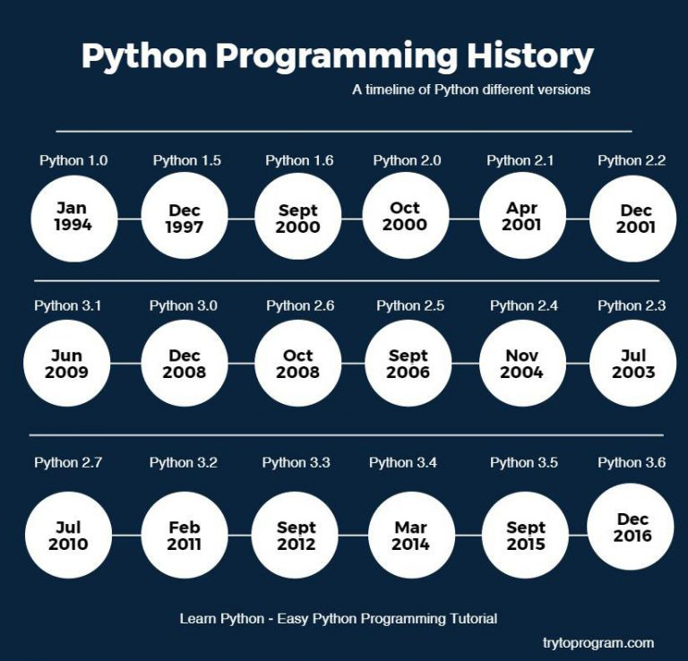
What is Python?
Created by Guido van Rossum and first released in 1991.
Named after British comedy show Monty Python.
Big step up between versions 2 and 3. Last versions:
v2.7.16: 2019 (obsolete since January 2020).
v3.14.x: latest version
https://www.python.org/downloads/

Slide 4

Options to work with Python
“Open-source” distribution for Python and R.
Simplifies the installation and use of different libraries allowing for different workspaces.

Slide 5

Options to work with Python
“Open-source” distribution for Python and R.
Simplifies the installation and use of different libraries supporting different workspaces.
Scientific Python Development EnviRonment.
Similar environment to Rstudio and Matlab.

Slide 6
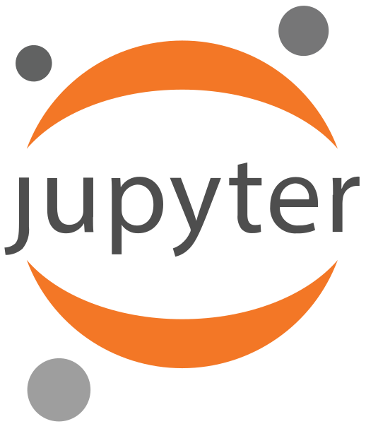
How are we going to work with Python?
“Open-source” distribution for Python and R.
Simplifies the installation and use of different libraries allowing for different workspaces.
Scientific Python Development EnviRonment.
Similar environment to Rstudio and Matlab.
File extensión: .py
Python (and R) open-source web application
Create documents/notebooks with executable code
File extension: .ipynb

Slide 7
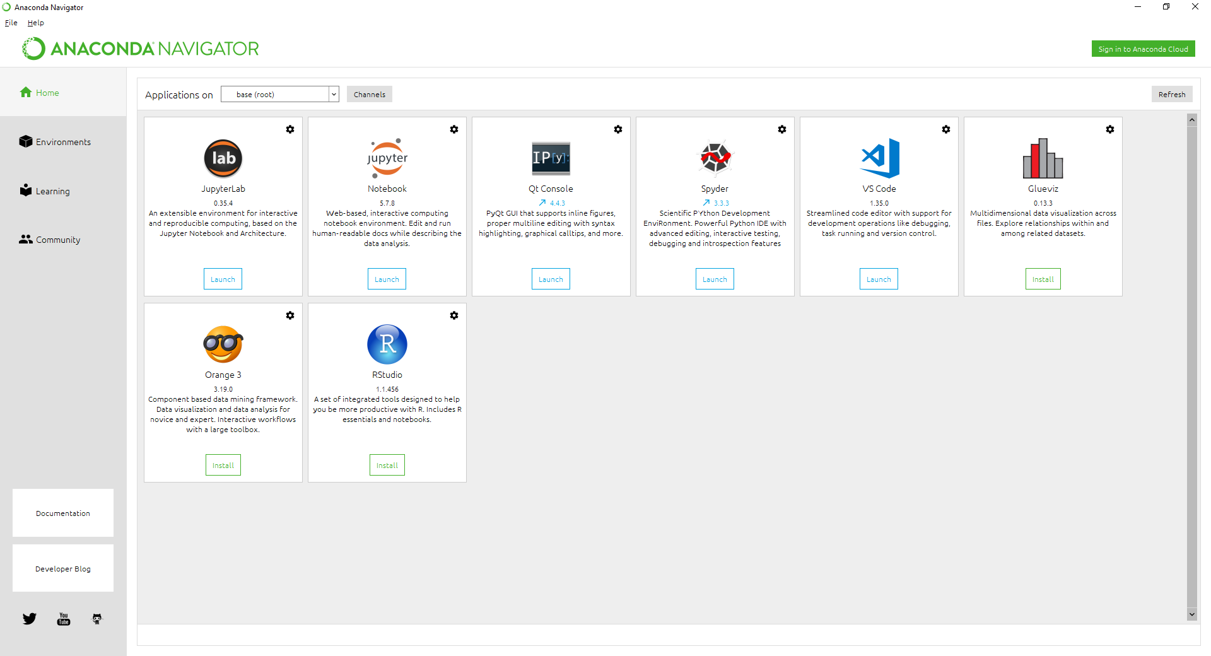
Anaconda
1

Slide 8
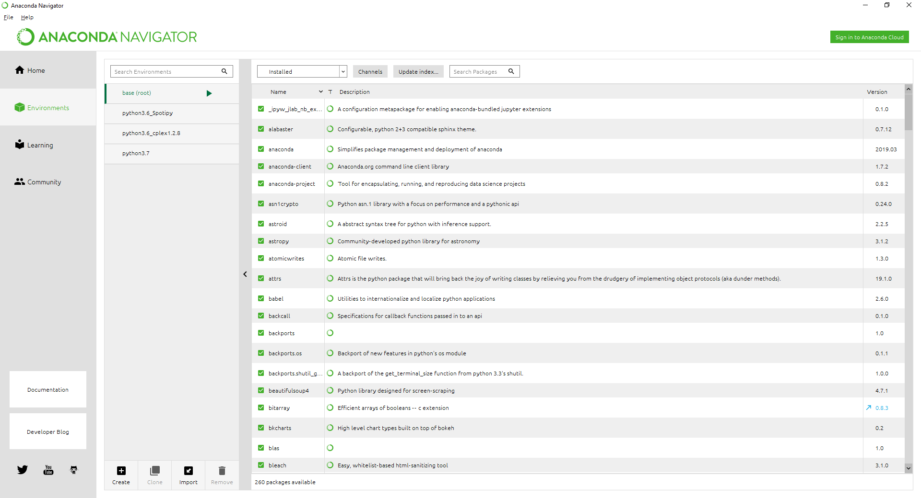
Anaconda
2

Slide 9
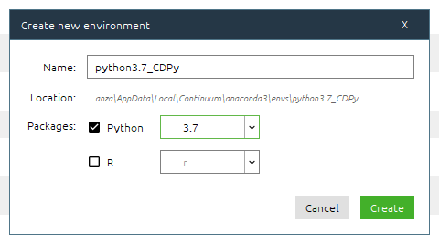
Anaconda
3

Slide 10
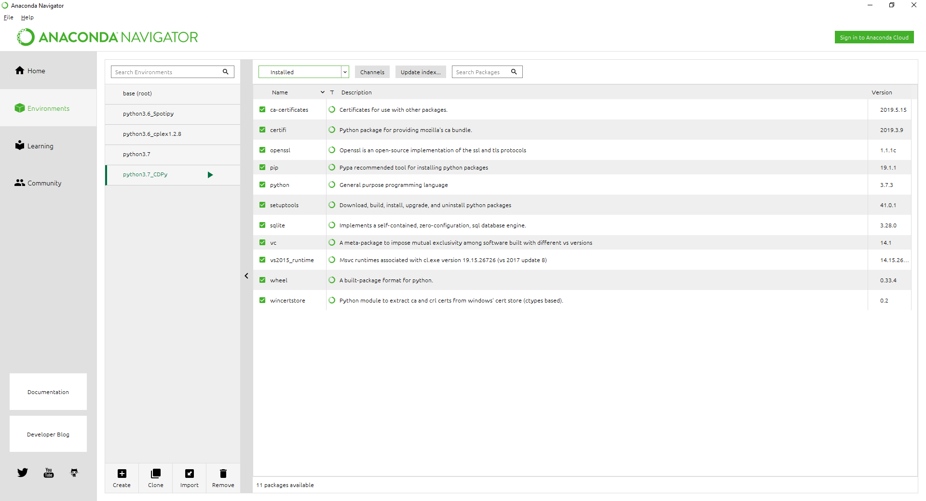
Anaconda
4

Slide 11
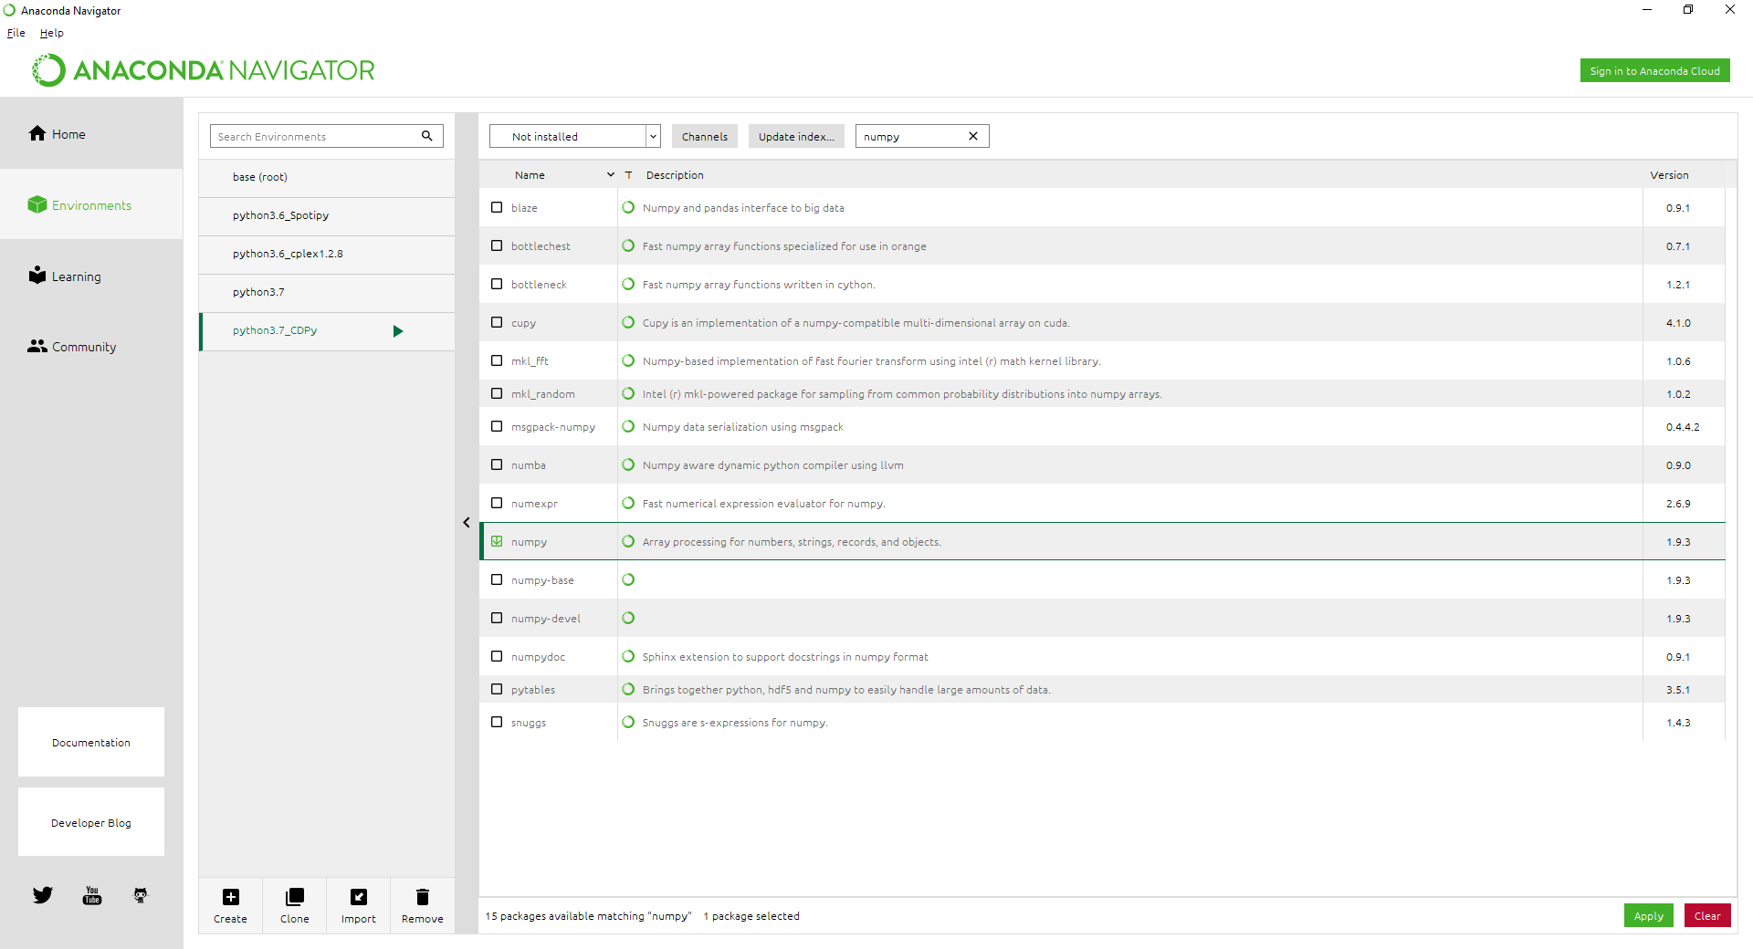
Anaconda
5
Modules:
matplotlib
notebook
numpy
pandas
scipy
spyder

Slide 12
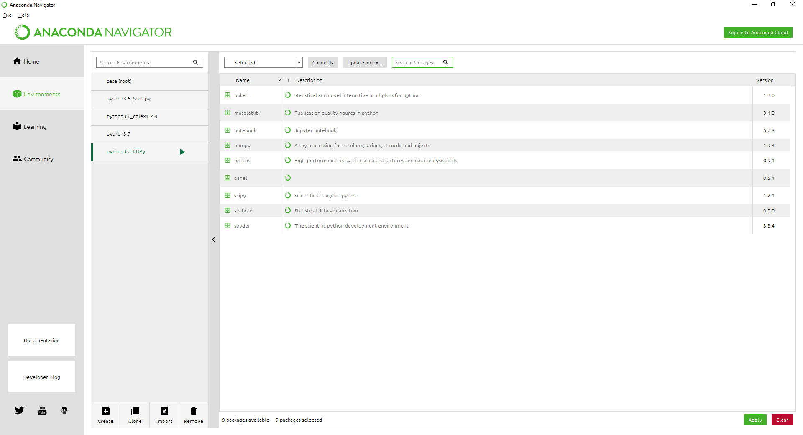
Anaconda
Modules:
matplotlib
notebook
numpy
pandas
scipy
spyder
seaborn
6

Slide 13
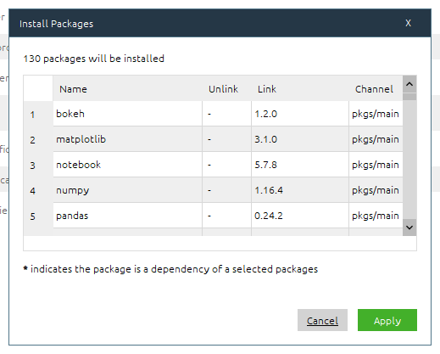
Anaconda
7

Slide 14
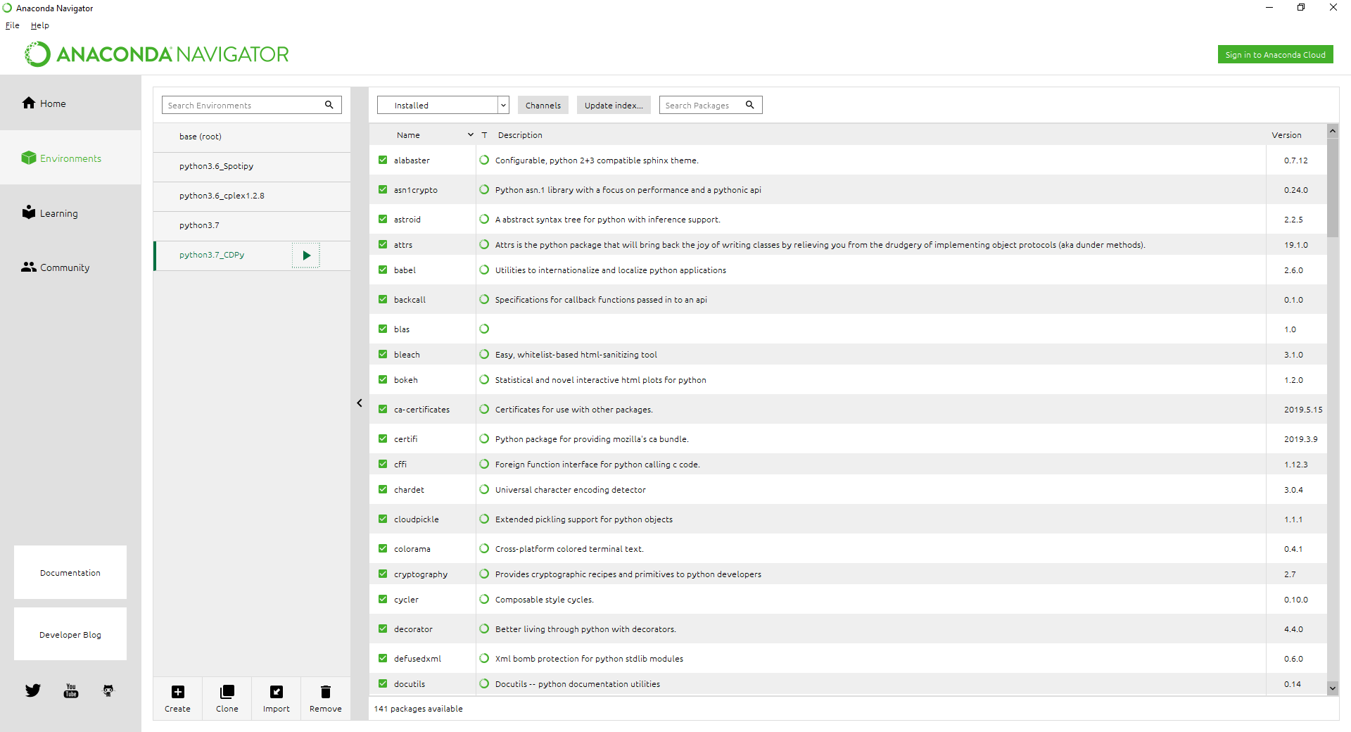
Anaconda

Slide 15
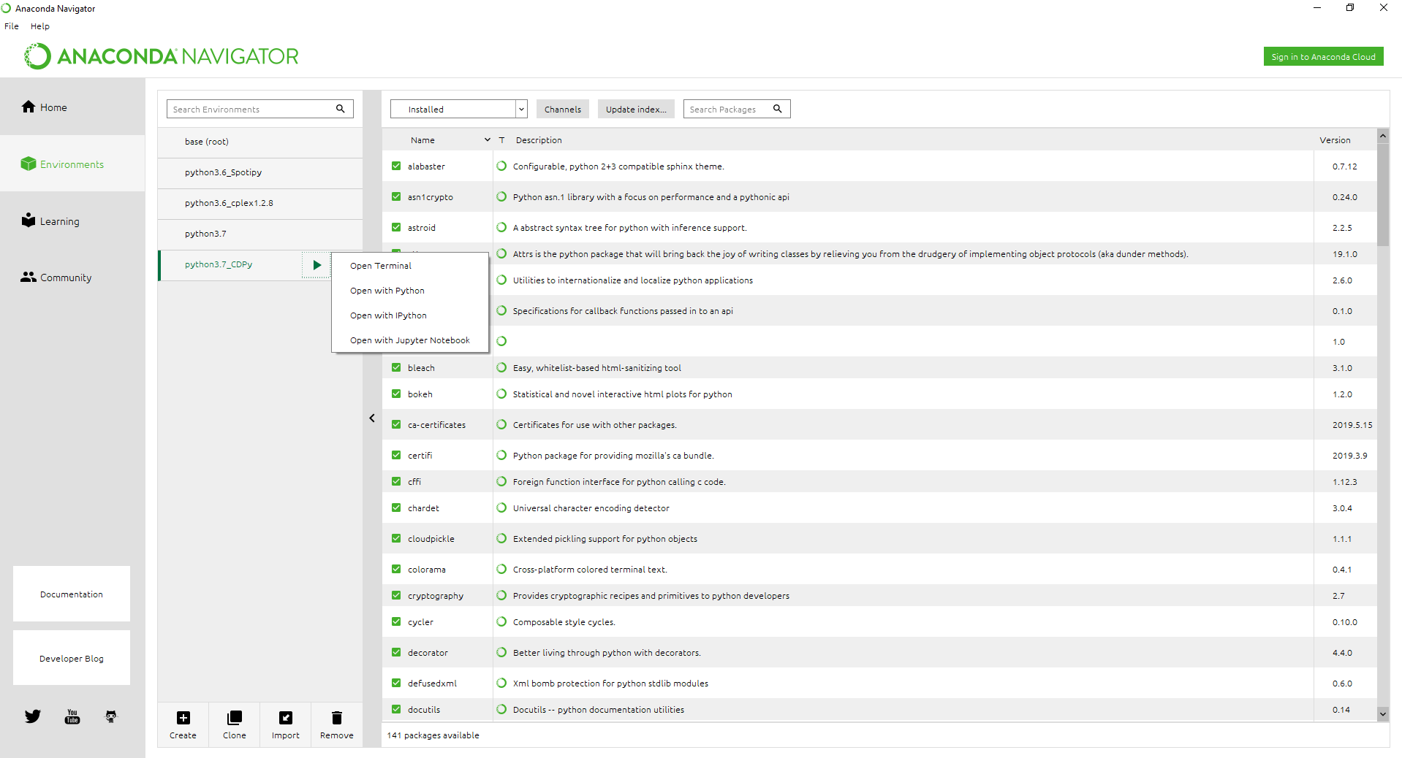
Anaconda

Slide 16
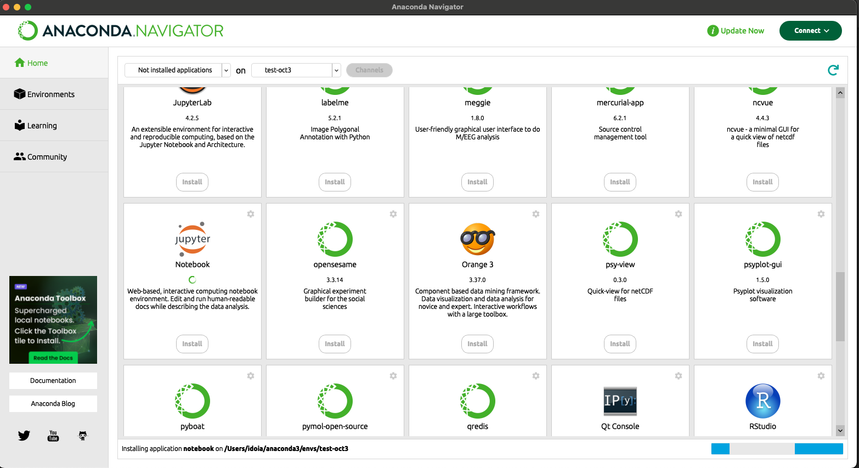

Jupyter Notebook in Anaconda

Slide 17
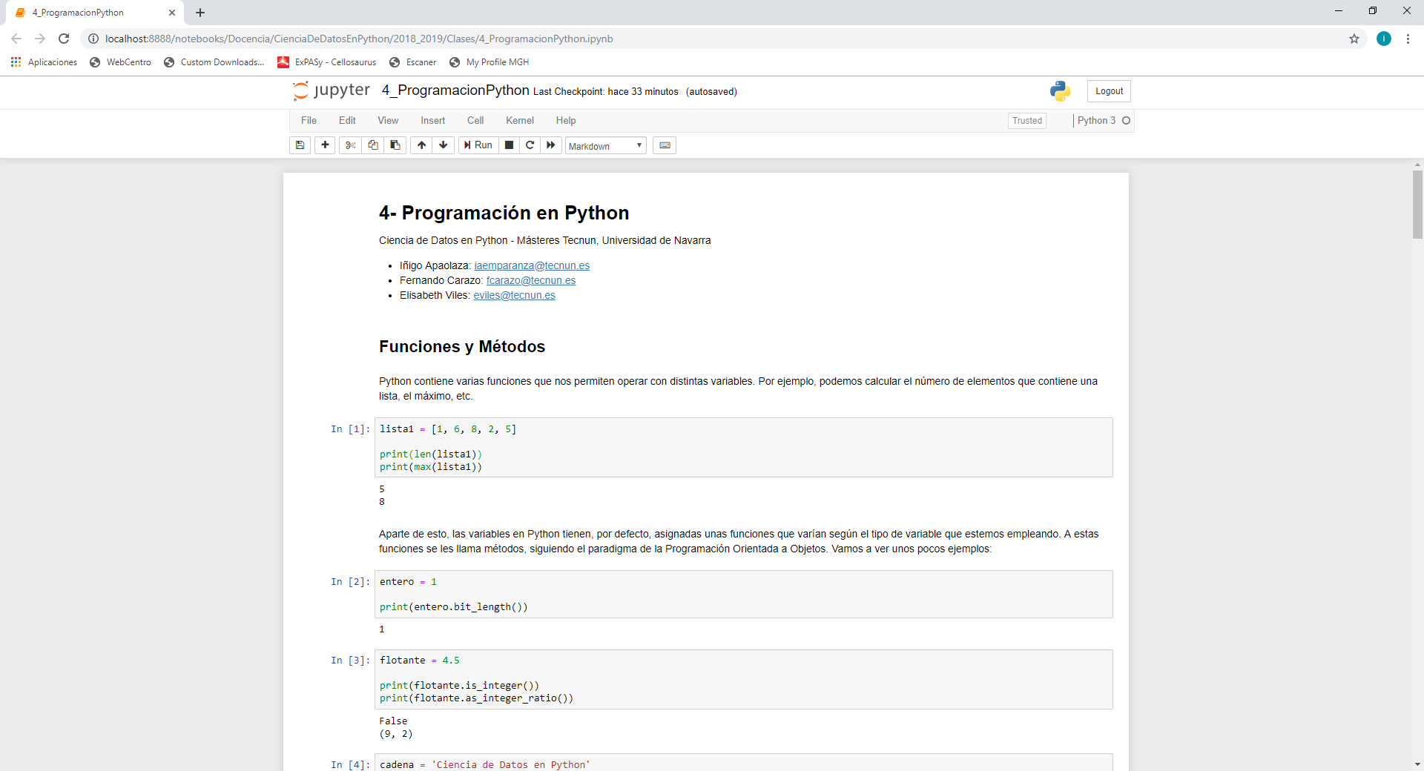
Jupyter Notebook

Slide 18

Jupyter Notebook with Google Colab
Run and create Jupyter Notebooks directly on the cloud (online!)
Easy to link to Google Drive
Simplifies the installation and use of different libraries.
What we will use in class

Slide 19
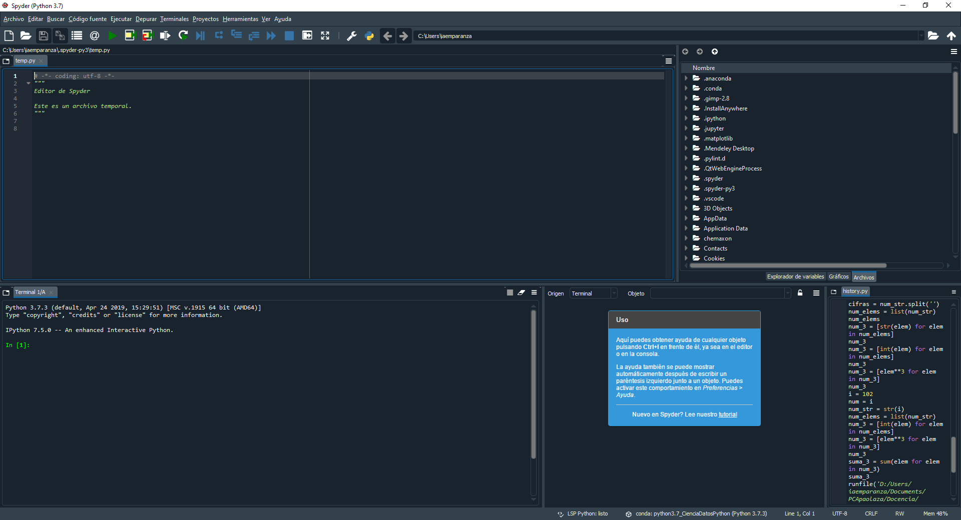

Spyder

Slide 20
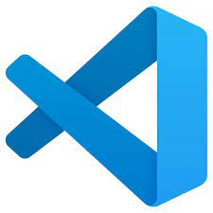

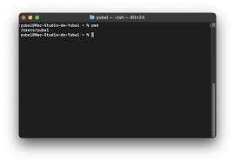
Other programs & resources
Visual Studio Code
PyCharm
Terminal

Slide 21
Other programs & resources
Visual Studio Code
PyCharm
Terminal
Programiz
https://www.programiz.com/python-programming/online-compiler/

Slide 22

Other programs & resources
Visual Studio Code
PyCharm
Terminal
Programiz
https://www.programiz.com/python-programming/online-compiler/

Slide 23
Other programs & resources
Combined with HPC Server to run highly demanding jobs
Visual Studio Code
PyCharm
Terminal
Programiz
https://www.programiz.com/python-programming/online-compiler/

Slide 24
Sample exercises
https://pynative.com/python-exercises-with-solutions/
https://www.kaggle.com/code/themlphdstudent/learn-numpy-numpy-50-exercises-and-solution
https://www.w3resource.com/python-exercises/puzzles/index.php
https://www.geeksforgeeks.org/python-exercises-practice-questions-and-solutions/

